Slide 1
Neden makine öğrenmesi? Yeni çağın petrolü: veri

Slide 2
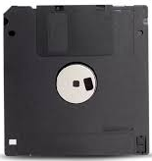




Taşınabilir Depolama Son 20 Yıl
1.44 MB
700 MB
4.7 GB
25 GB
17.777 kat
Bilgi depolamak artık çok ucuz ve kolay

Slide 3


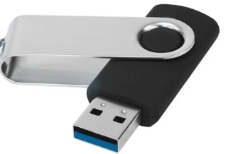
1 USB Kaç Ağaç Eder?

Slide 4
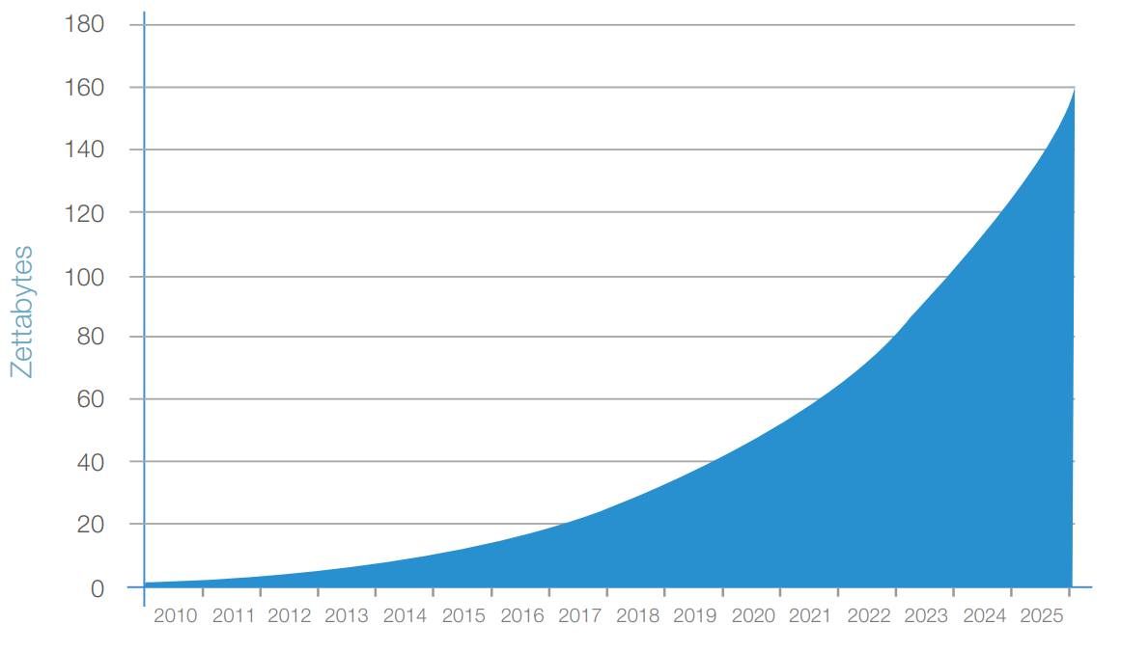
Veri Artış Tahmini
Kaynak: https://www.seagate.com/files/www-content/our-story/trends/files/Seagate-WP-DataAge2025-March-2017.pdf

Slide 5
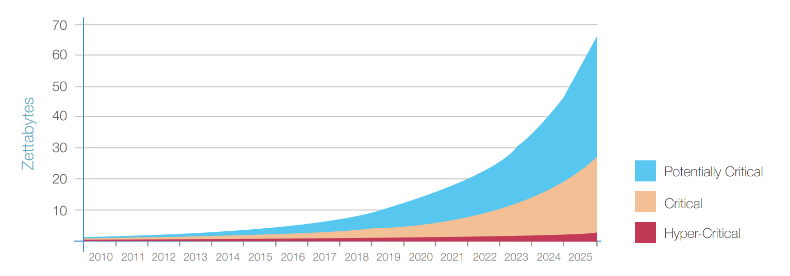
Kritik Veri Trendi
Kaynak: https://www.seagate.com/files/www-content/our-story/trends/files/Seagate-WP-DataAge2025-March-2017.pdf

Slide 6

Veri mi artıyormuş?
Artsın, bana ne!
Big Data
Machine Learning
Statistics
AI, Deep Learning
……
Kaynak: https://www.seagate.com/files/www-content/our-story/trends/files/Seagate-WP-DataAge2025-March-2017.pdf

Slide 7
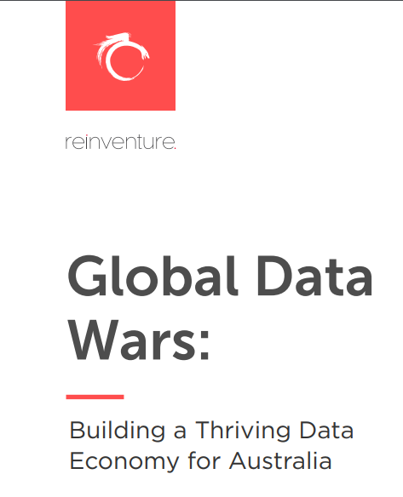
Başkaları bana ne demiyor
Over the last four years, Reinventure has worked at the
centre of Australia’s fintech community, investing in the
likes of Data Republic, HyperAnna and Basiq. As a result
of these experiences,
we have formed a deeply held
belief that data is the single biggest lever for
microeconomic C social reform in the next two
decade, and needs to be a material part of policy and trade consideration at all levels of thinking in the public and private sector.
data is the single biggest lever for
microeconomic C social reform in the next two decade
Kaynak: http://reinventure.com.au/wp-content/uploads/2016/10/GlobalDataWarsReportReinventure.pdf

Slide 8

Kaynak:
https://medium.com/@adeolaadesina/data-is-the-new-oil-2947ed8804f6

Slide 9

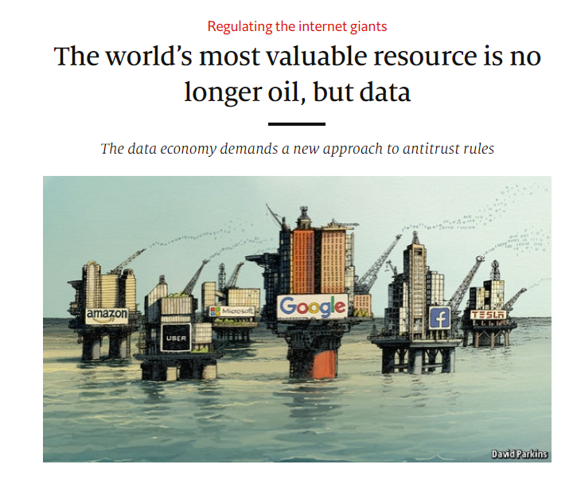
A century ago, the resource in question was oil. Now similar concerns are being raised by the giants that deal in data, the oil of the digital era. These titans—Alphabet (Google’s parent company), Amazon, Apple, Facebook and Microsoft—look unstoppable.

Slide 10



Farkında Olanlar Var!
Obama Administration launched Big Data Research and Development Initiative (Weiss and Zgorski, 2012) with a budget of 200 million.
In Japan, Big Data development became one important axe of the national technological strategy in July 2012 (Chen et al., 2014b).
The United Nations issued a report entitled Big Data for Development: Opportunities and Challenges (Letouzé, 2012). It aims to outline the main concerns about Big Data challenges and to foster the dialogue about how Big Data can serve the international development.

Slide 11
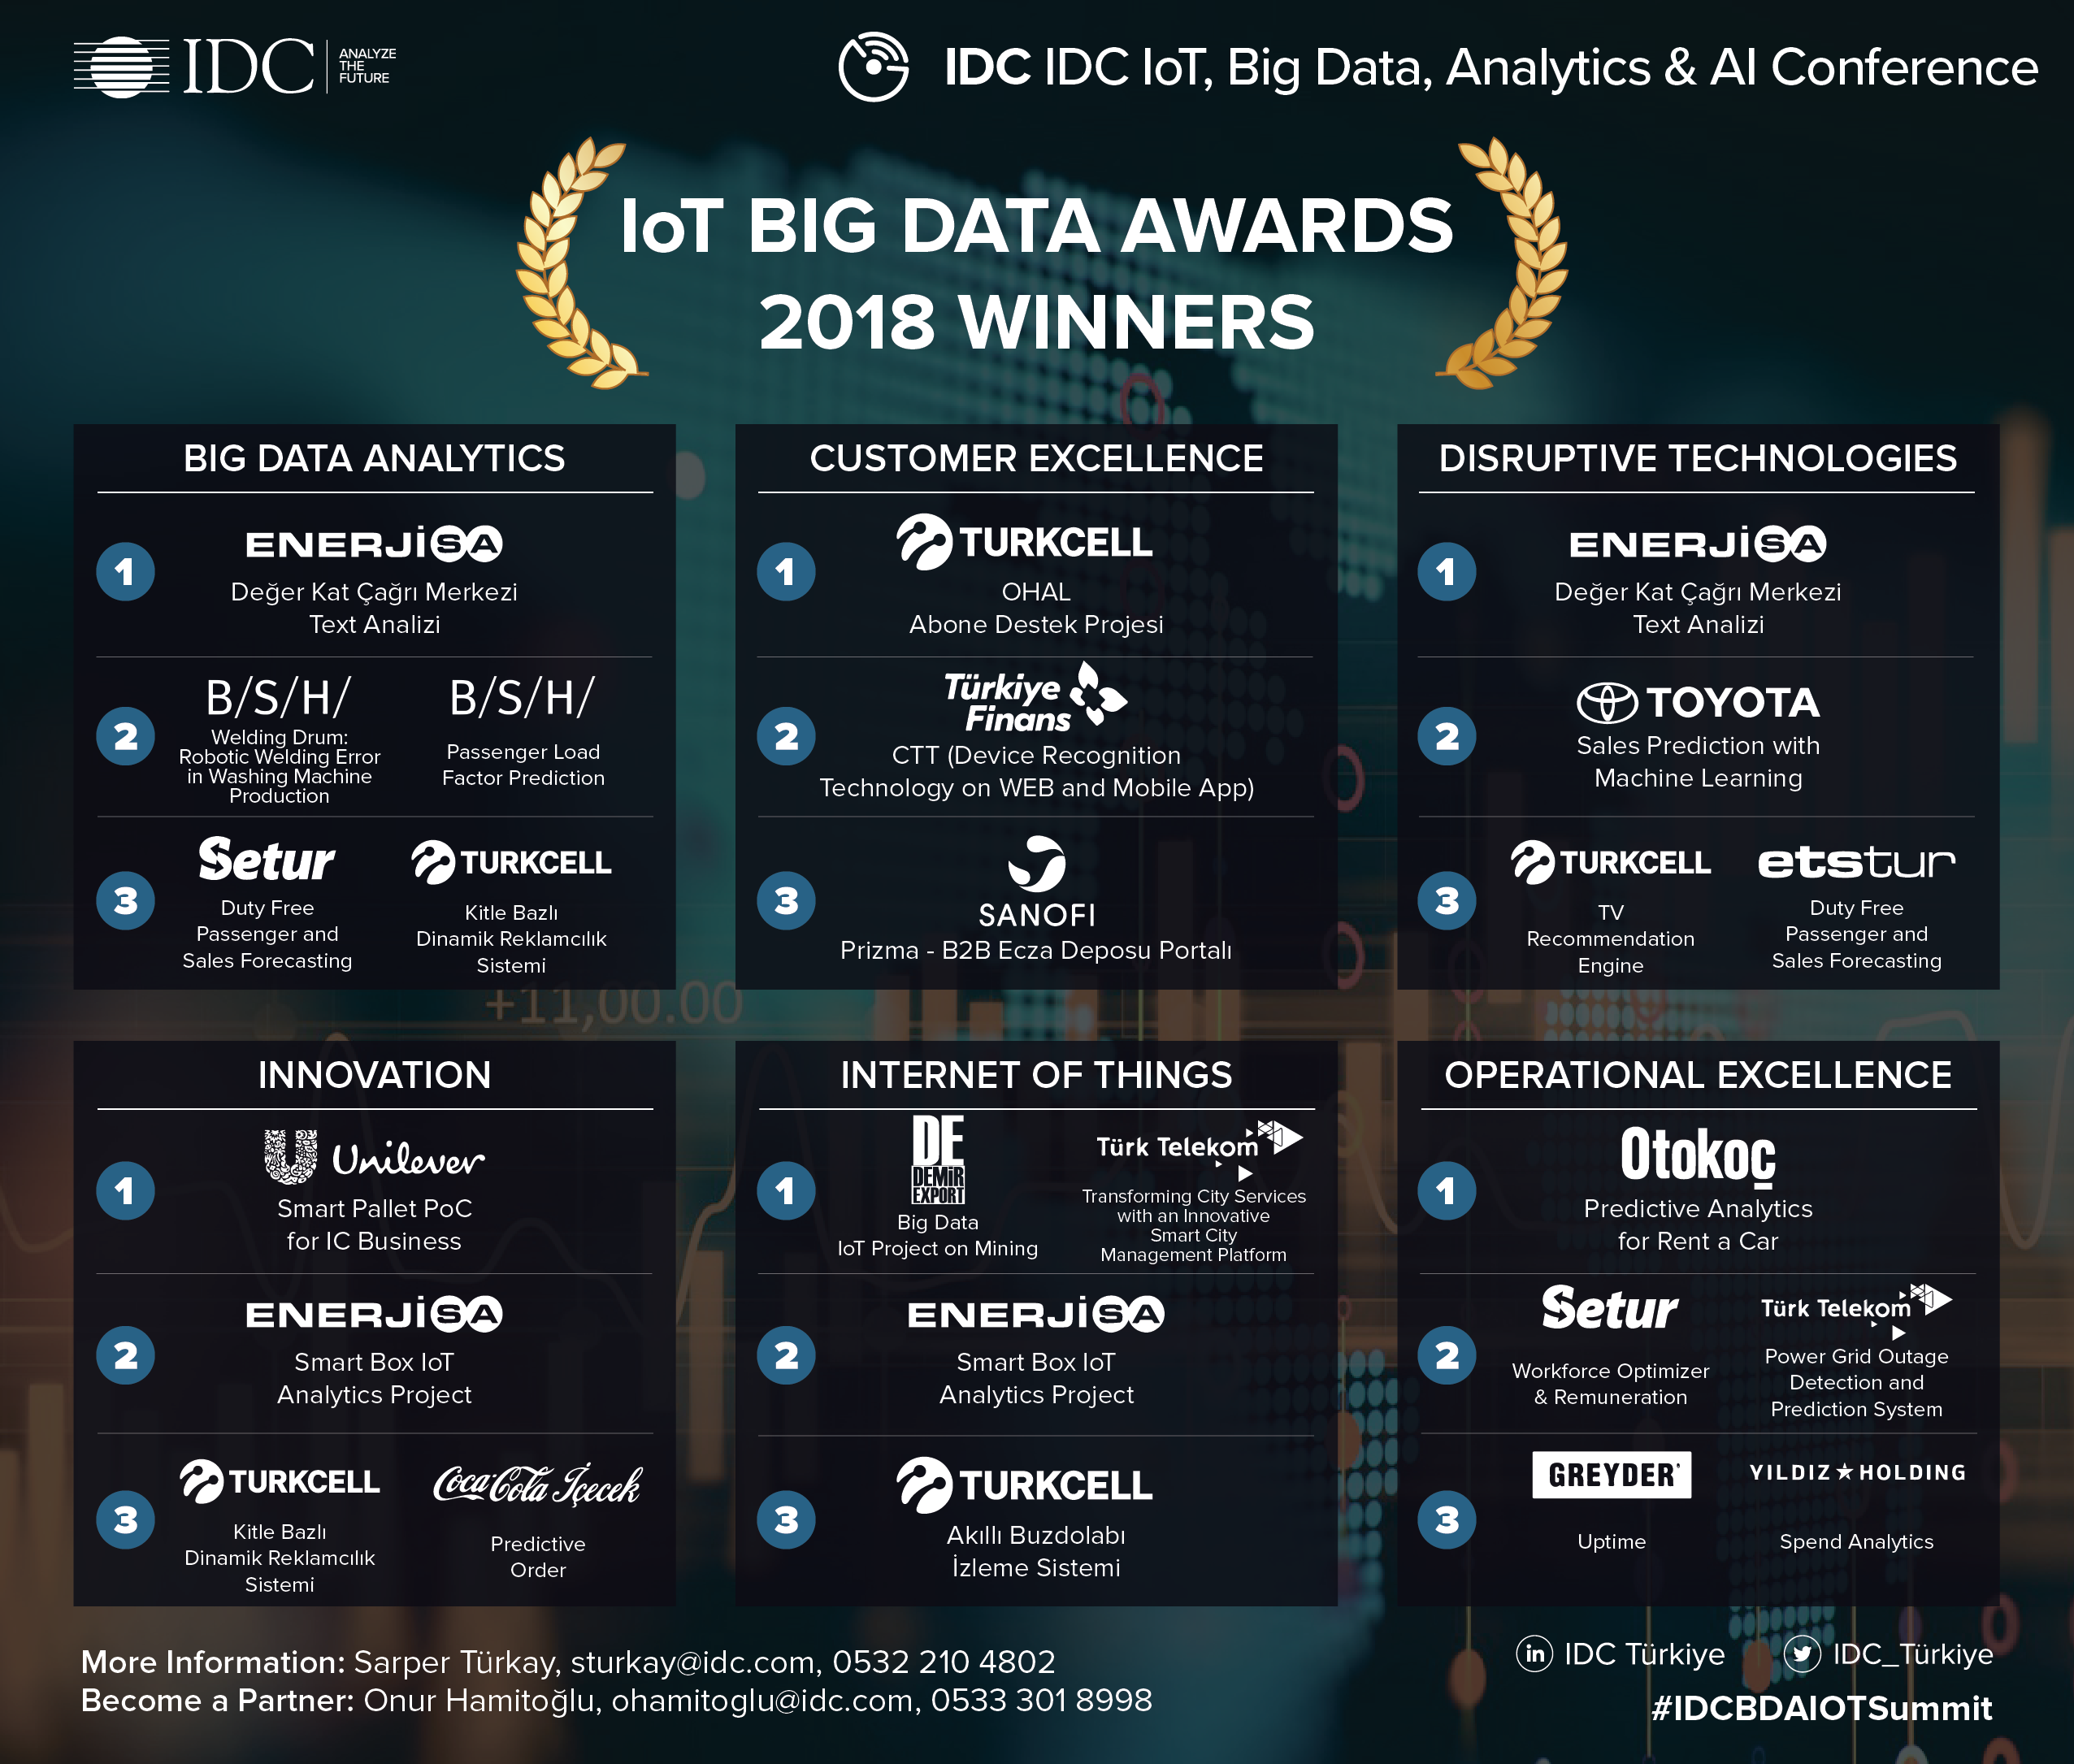

Ülkemizde Farkında Olanlar
International Data Corporation (IDC)

Slide 12

Kamu
75 konuşmacı arasında kamu sektöründen katılım yok

Slide 13
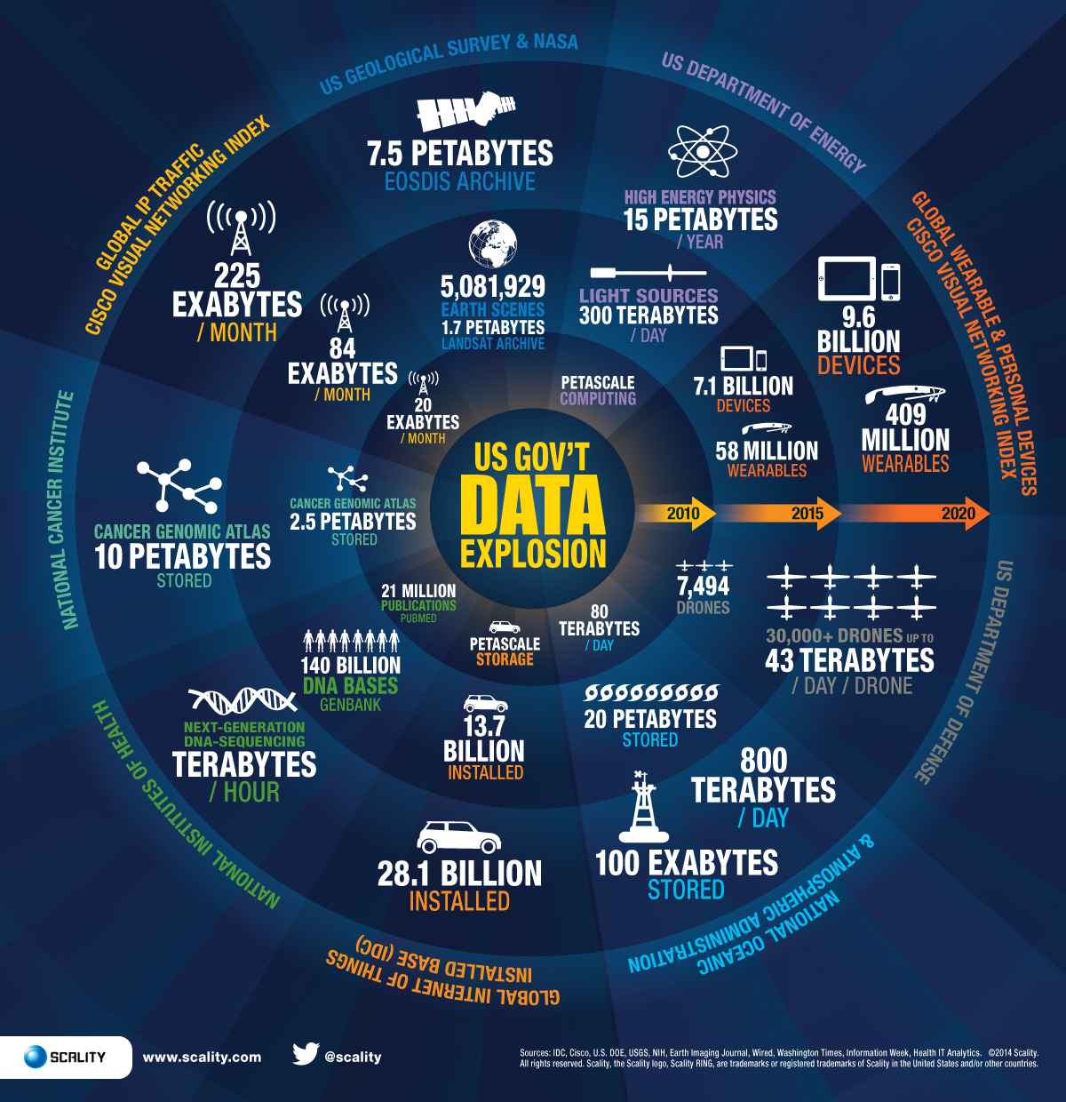

Yıl 2014: ABD Hükümetinin İşlediği Veri

Slide 14
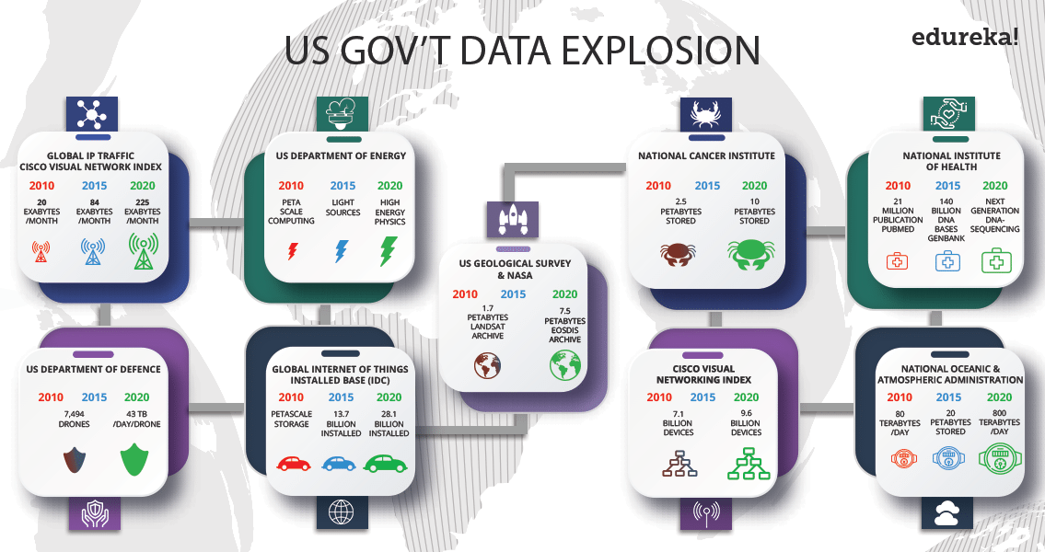
Görsel: https://www.edureka.co/blog/big-data-applications-revolutionizing-various-domains/

Slide 15
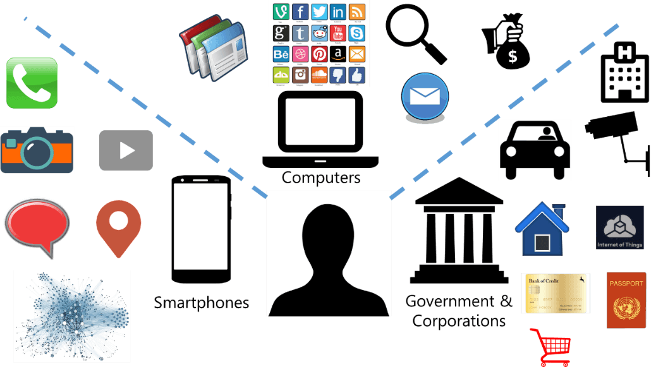
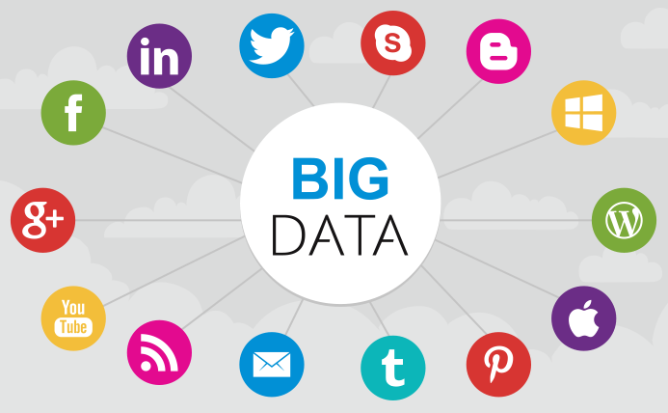

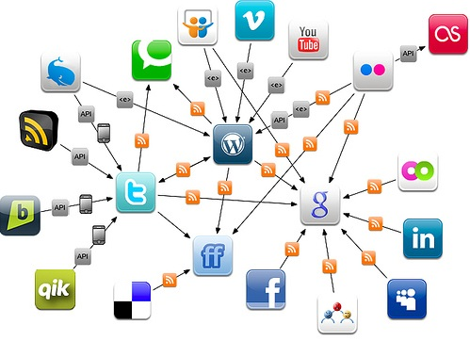
Görsel: https://www.bankinfosecurity.com/gao-assesses-iot-cybersecurity-other-risks-a-9926

Slide 16

Veri her yerde

Slide 17
Bütün bu cihazlar veri üretmeye başladığında buna hazır olacak mısınız?

Slide 18
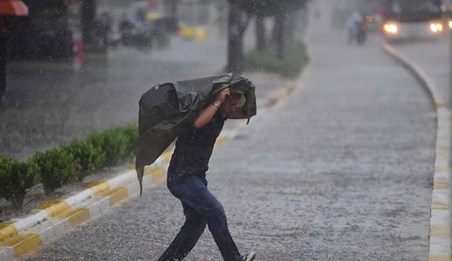
Hazırlıksız yakalanmayın. Şimdiden tedbirinizi alın.
Görsel: https://www.trthaber.com/haber/turkiye/meteorolojiden-saganak-yagis-uyarisi-211683.html

